Slide 1

HotSizzlers Restaurant Management System
SQL Project - Managing Orders, Customers, Delivery, and Discounts
Shweta Bhagat

Slide 2
This project aims to create a Restaurant Management System that helps restaurants manage their food catalogue, customer orders, delivery system, and premium customer discounts efficiently using SQL.
Objective:
Skills Demonstrated:
SQL Querying
Database Design
Data Relationships (Joins, Foreign Keys)
Normalization & Data Integrity

Slide 3
Problem Statement
Scenario: HotSizzlers Restaurant need to handle large volumes of orders, customer data, and delivery assignments effectively. Additionally, they need to manage discounts for premium customers and restrict delivery based on area codes.
Challenges:
Food Catalog Management: Storing and retrieving food items efficiently.
Order Management: Handling customer orders and delivery assignments.
Premium Customer Discounts: Managing customer loyalty programs.
Delivery Area Restriction: Ensuring delivery boys only serve customers within their area.

Slide 4
Database Design Overview
Database Components:
Customers: Stores customer details, including premium membership.
FoodItems: Stores the restaurant's menu items.
Orders: Tracks customer orders.
OrderDetails: Captures the details of food items in each order.
DeliveryBoys: Tracks delivery boys and their assigned area codes.
OrderAssignments: Links orders with delivery boys based on area codes.

Slide 5
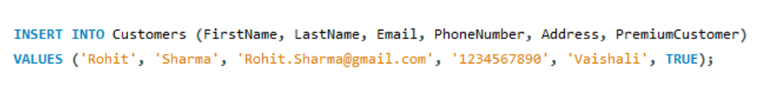
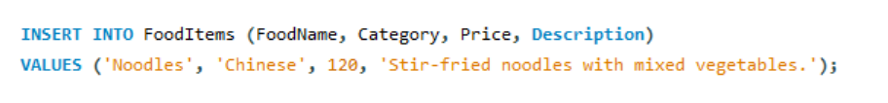
SQL Query Implementation
Inserting Customer Data:
Inserting Food Item Data:

Slide 6


Inserting an Order:
Inserting Order Details:

Slide 7
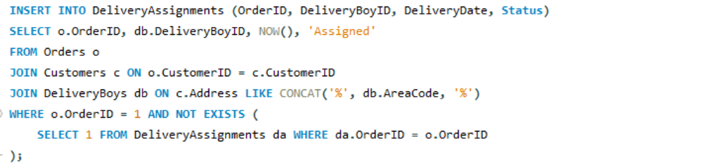
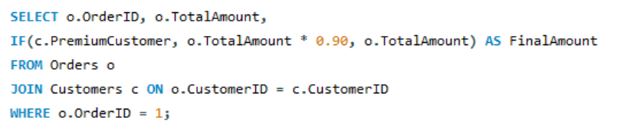


Assigning Delivery Boy to an Order Based on Area Code:
Calculating Final Amount After Discount:

Slide 8
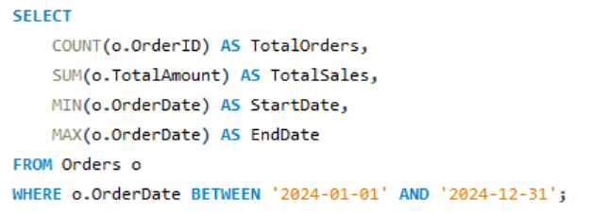
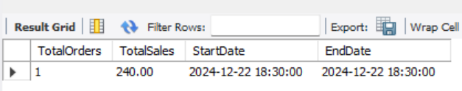
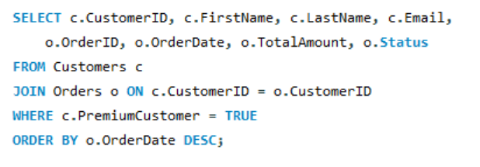
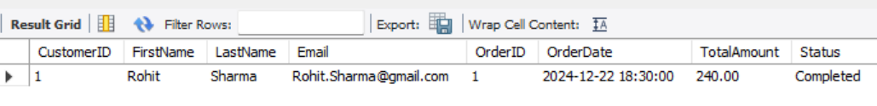
Generating Sales Report for a Specific Date Range:
Identifying Premium Customers and Their Orders:

Slide 9
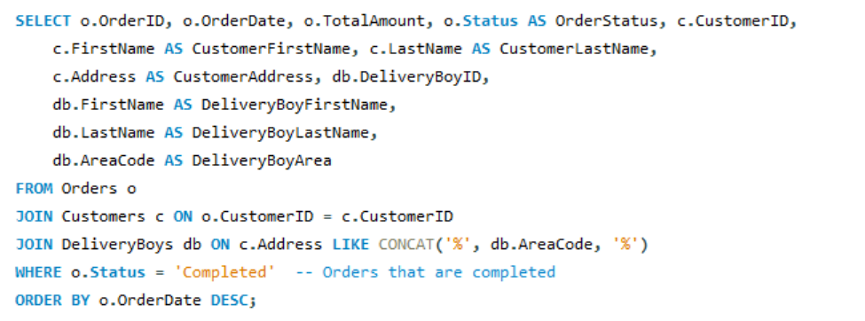
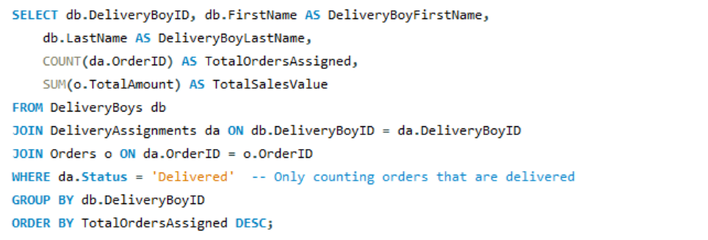
Handling Orders from Multiple Areas (Complex Join):
Tracking Delivery Boys' Performance (Orders Assigned):

Slide 10
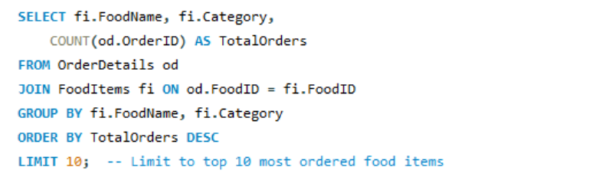
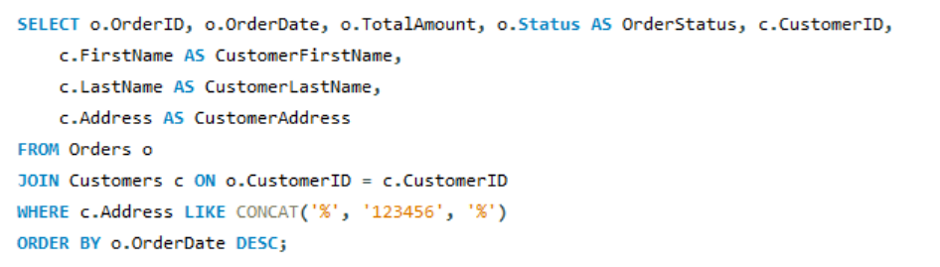
Finding the Most Ordered Food Items:
Filtering Orders for Customers in Specific Area Code:

Slide 11
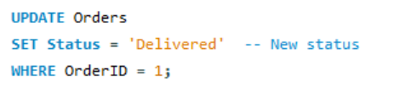

Updating Order Status:
Removing Food Items from the Menu:
Deleting directly from “FoodItems” table results in an error (Code 1451) because it’s referenced in the “OrderDetails” table, preventing deletion due to the foreign key constraint.
Alternate Solutions:
ON DELETE CASCADE: Automatically deletes related orders.
ON DELETE SET NULL: Sets related food item reference to NULL.

Slide 12
Challenges Faced | Solutions Implemented
Data Integrity: Ensuring correct relationships between tables and preventing data anomalies using foreign keys and constraints. | Normalization: The database schema was normalized to 3NF to remove redundancy and ensure efficiency.
Complex Joins: Handling complex queries that involve multiple tables with different relationships, such as joining orders with customers, food items, and delivery boys. | Dynamic Querying: Implemented dynamic SQL queries for operations like calculating discounts, handling orders, and generating reports.
Premium Customer Logic: Managing discounts and ensuring premium customers are given the correct benefits. | Area Code Check: The AreaCode restriction was implemented using SQL joins to ensure delivery boys only get assigned orders within their designated area codes.

Slide 13
Conclusion
Summary: This project successfully built a Restaurant Management System with a well-structured SQL database to handle customer orders, food catalog management, delivery boy assignments, and premium customer discounts.
Impact: The system improves restaurant efficiency by streamlining order processing, improving customer satisfaction, and ensuring correct delivery assignments.

